Slide 1
Flight Reservation System
Access MySQL Database from Java Example

Slide 2
Flight Management System
Requirements Analysis

Slide 3
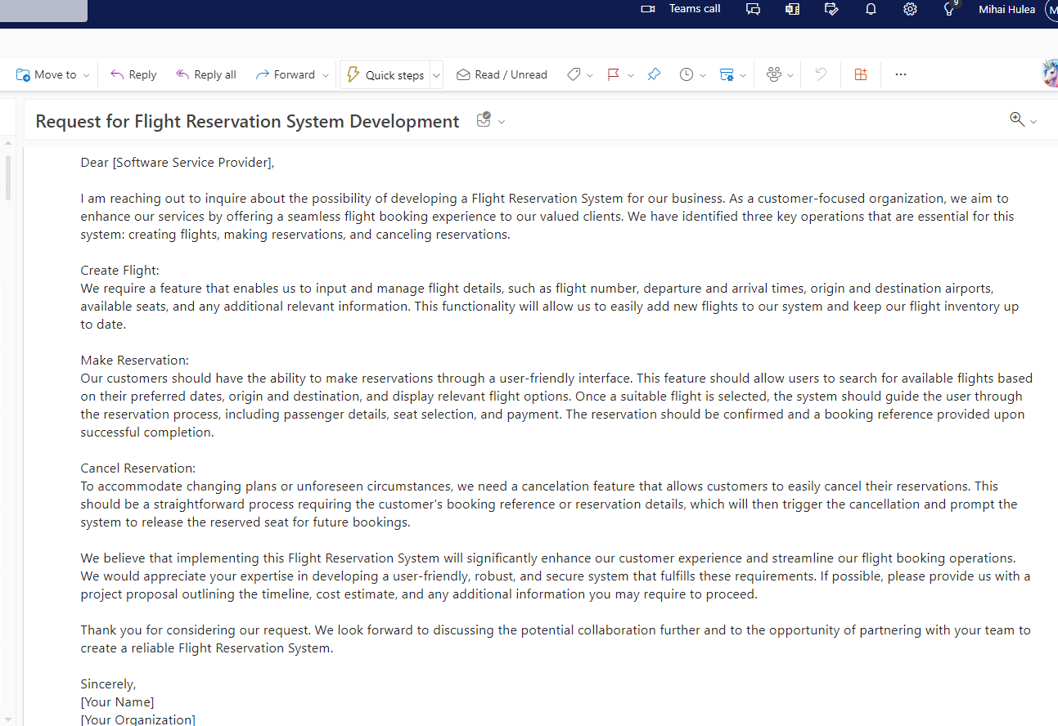
Scenario – Client is contacting us for requesting a new solution

Slide 4
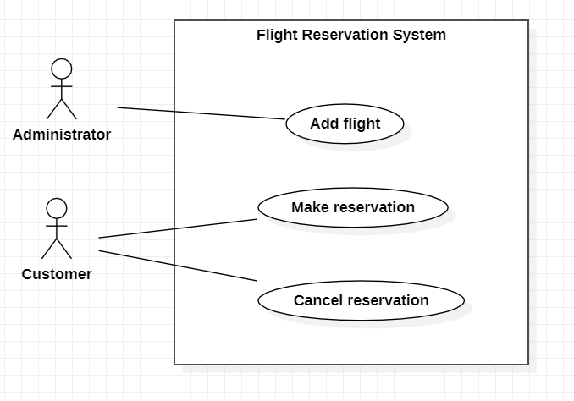
Analyze requirements

Slide 5
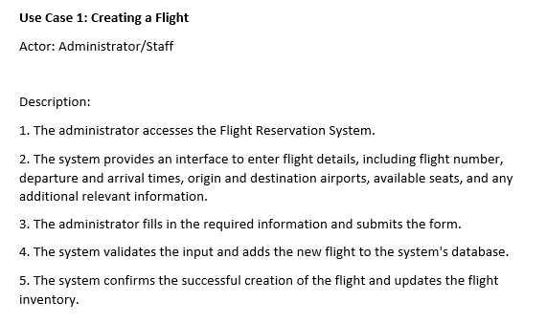
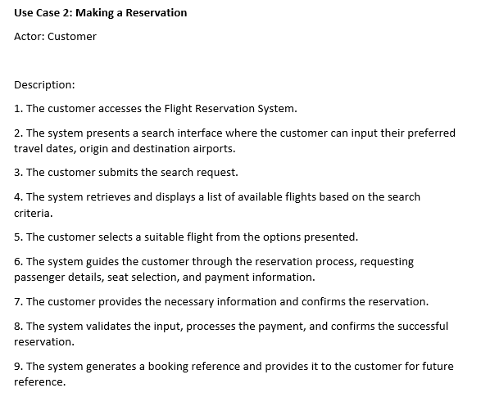
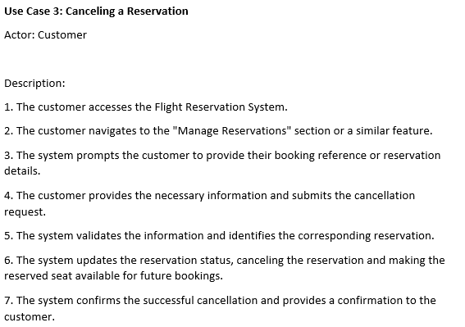



Slide 6
Flight Management System
Architecture

Slide 7
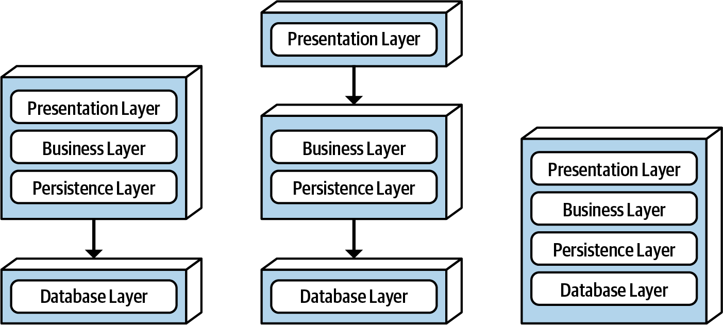
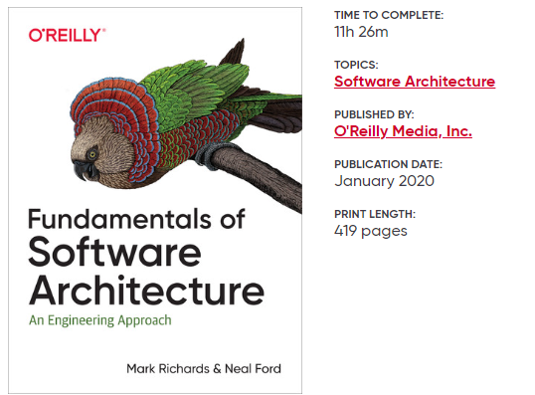


Layered Architecture Style
Figure illustrates the various topology variants from a physical layering (deployment) perspective in context of a layered architecture style.
Recommended reading:
Java Swing Desktop Application
JDBC access driver
MySQL Database Server
Our approach

Slide 8









Tools\ Technology Stack
StarUML
NetBeans
Java SDK
MySQL Database Server
MySQL Workbench
Draw.io

Slide 9
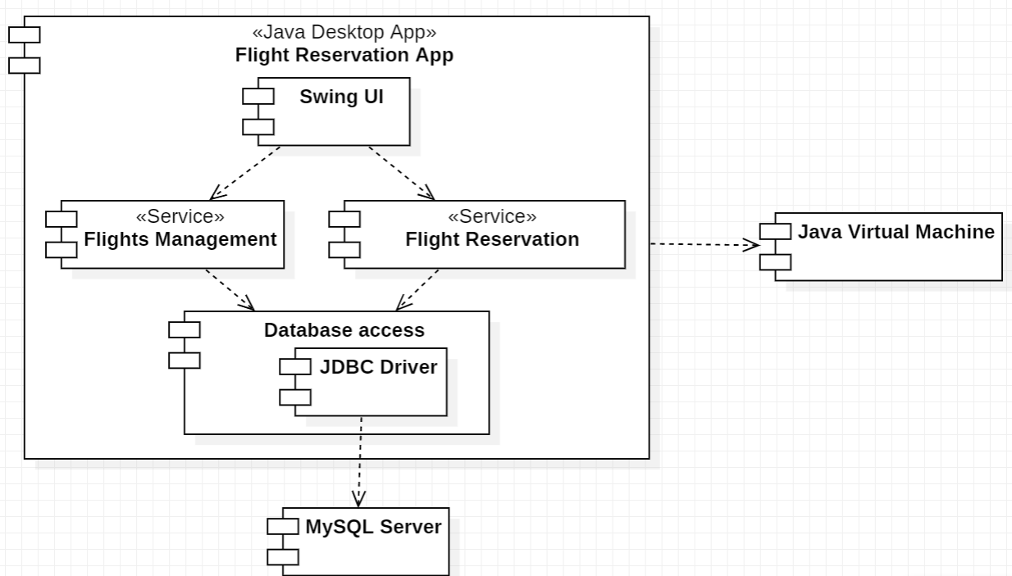
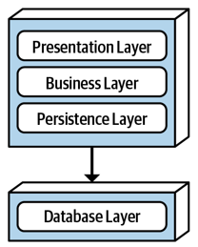




High level architecture

Slide 10
Flight Management System
Implementation Details

Slide 11
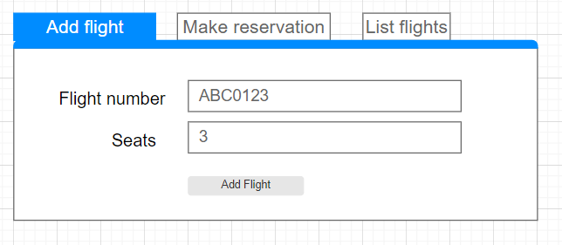
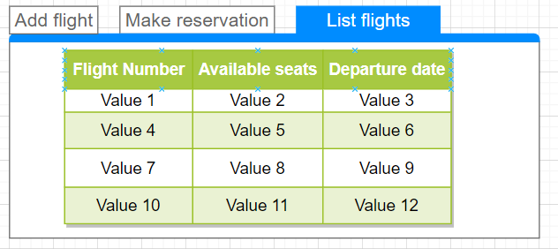
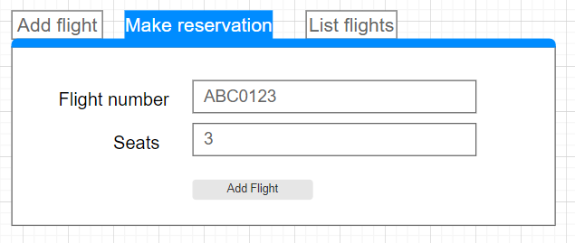
UI mockups & Design (Wireframes)

Slide 12
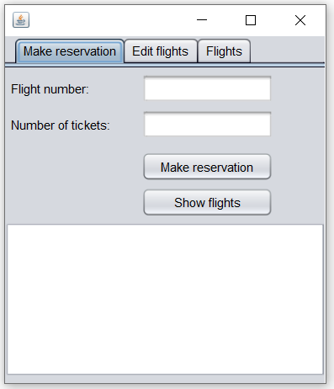
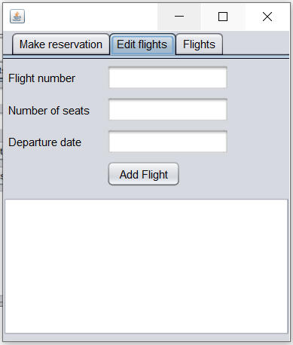
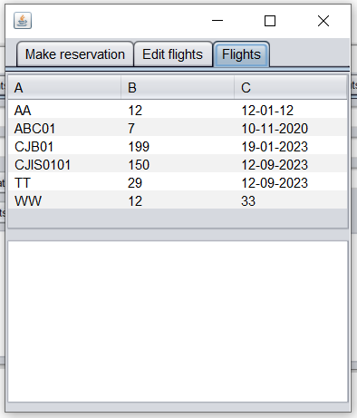
UI mockups & Design (Design)

Slide 13
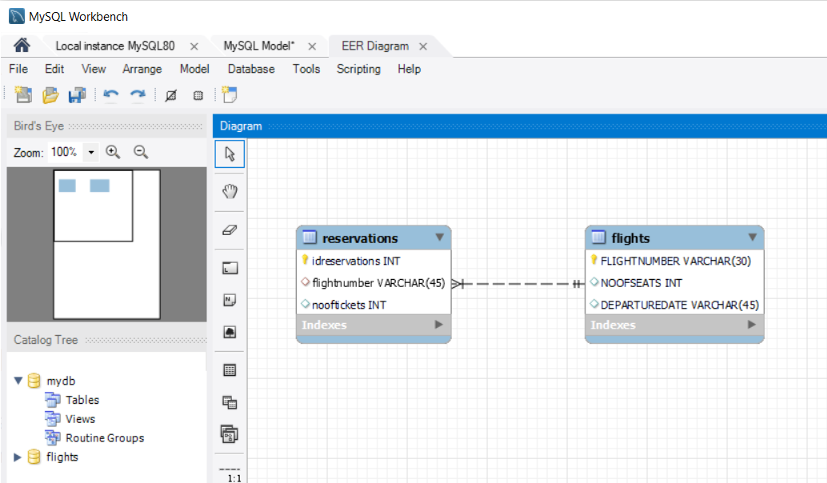
Database diagram

Slide 14
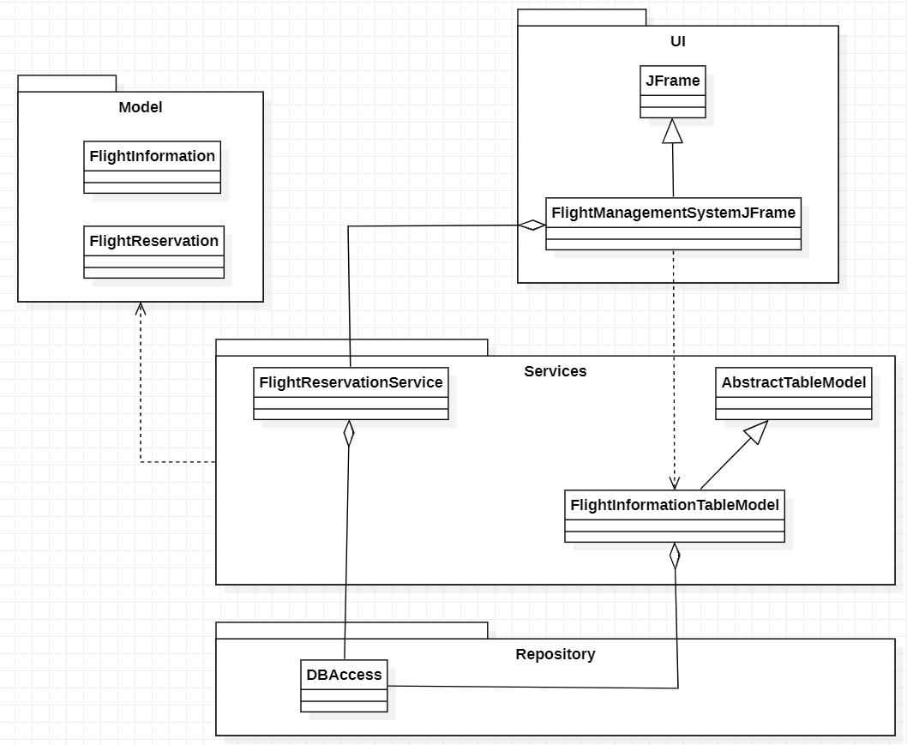



UML Class Diagram

Slide 15
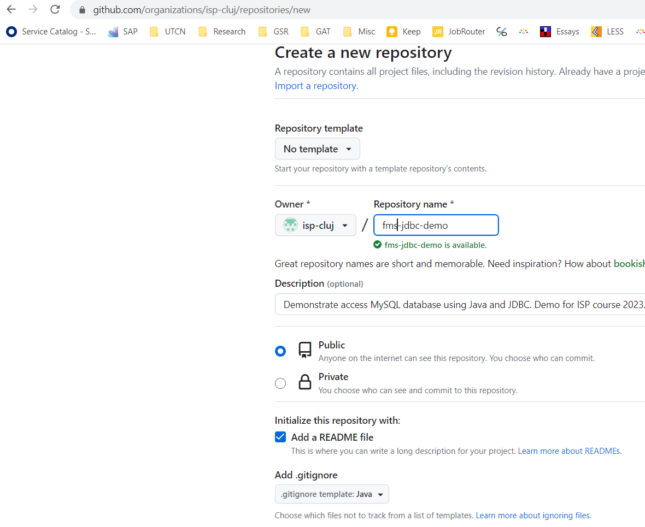
Prepare development environment & repository
Create git repository
Clone on local computer repository
Create initial maven project (in NetBeans for this example) and save it in local cloned repository
Start development
https://github.com/isp-cluj/fms-jdbc-demo

Slide 16

Implementation & Testing

Slide 17
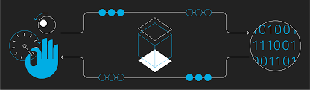
Deployment & Maintenance

Slide 18
Project Closing

